Slide 1
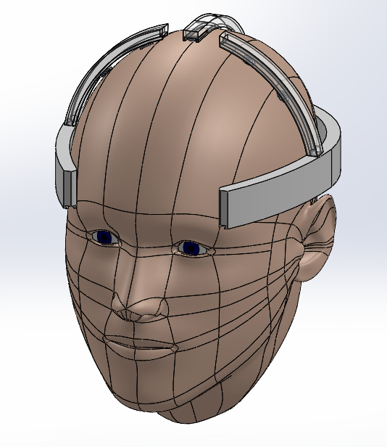
Epileptic Monitoring Device
Final Design Presentation – December 4 2013
Mark Curran (CE), Rachel Kolb (BME), Kevin Pineda (BME), & Timothy Skinner (EE)
Primary Advisor: Dr. Brett BuSha Secondary Advisor: Dr. Ambrose Adegbege

Slide 2
Agenda
Introduction
Problem/Solution
Design Overview
Electrodes
Headset Design
Signal Processing
Microcontroller
Android device/application
Budget
Timeline
Conclusion

Slide 3
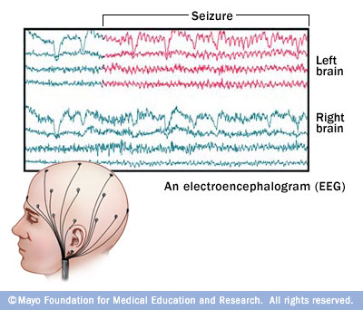
Introduction
Electroencephalography (EEG)- Test that measures and records electrical activity such as voltage fluctuations from ionic current flows within neurons of the brain
Utilizes electrodes
Used mainly for diagnosis of epilepsy
Epilepsy- Neurological disorder, characterized by
Sudden, recurrent episodes of sensory disturbance
Loss of consciousness or convulsions
Abnormal electrical activity in the brain
Affects nearly 3 million Americans
200,000 new cases per year
Cost upwards of $17.6 billion annually
Current treatment options
Drug therapy e.g. anticonvulsant drugs
Surgery

Slide 4
Problem/Solution
Epileptic seizures- random occurrence, extremely difficult to accurately record outside hospital
Time consuming and expensive for caretakers to constantly watch epileptic patients
High risk if patient lives alone
Cost of healthcare per person per year: $4000
Solution: Create an ambulatory epileptic monitoring device that triggers an alarm to a caregiver/physician when the patient is experiencing an epileptic seizure. Our device will store EEG information, and will be cost-effective, portable, and suitable for everyday use outside of a hospital for patients undergoing treatment for epilepsy.

Slide 5
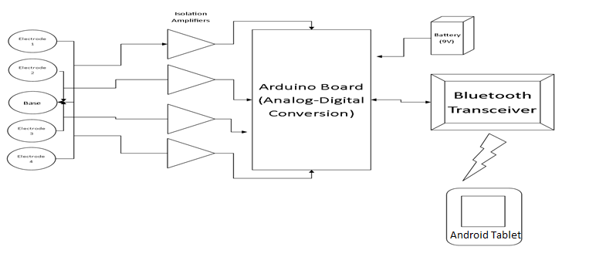
Design Overview
Electrodes
Isolation Amplifiers
Microprocessor
Battery and Signal Communication

Slide 6
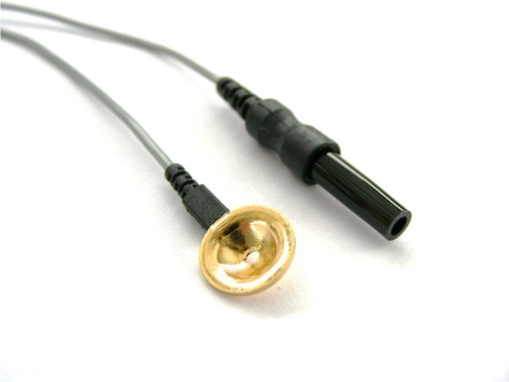
Electrodes
Number of electrodes directly related to spatial resolution of cortical potential distribution
Successful EEG readings have been taken using 4 electrodes
Clinically relevant EEG frequency band is 0.1 to 100 Hz, amplitudes along the scalp range 10-100 uV and vary by location

Slide 7
Electrode Arrangement
10-20 International System
Electrode arrangements can vary from using 1 to >256 electrodes

Slide 8
Electrodes for Design
5 electrodes at T3, C3, Cz, C4, and T4. Cz is reference
Cz is centrally located, not subject to asymmetrical electrical impulse propagation
Referential montage arrangement

Slide 9
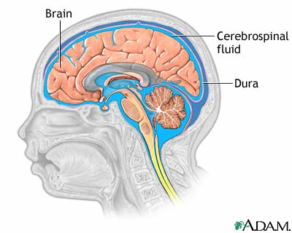
EEG Signals
Volume Conductor Effects
Signal conductivity non-linear
Cerebrospinal fluid
Non-homogeneous compartments, lesions, directionally dependent tissues
Bio-electric activities
Eye movement, muscle and cardiac activity
Outside noise
Inherent resistivity from skull and scalp
1:80:1 brain, skull, scalp

Slide 10
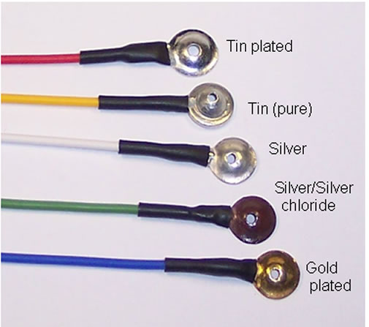
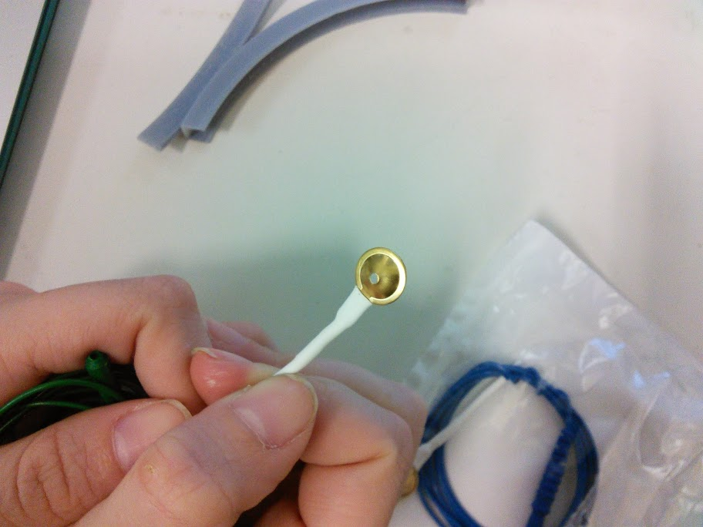
Type of Electrodes
Disposable or reusable
Reusable
Wet or dry
Wet
Shape
Cup disc
Material
Gold plated silver

Slide 11
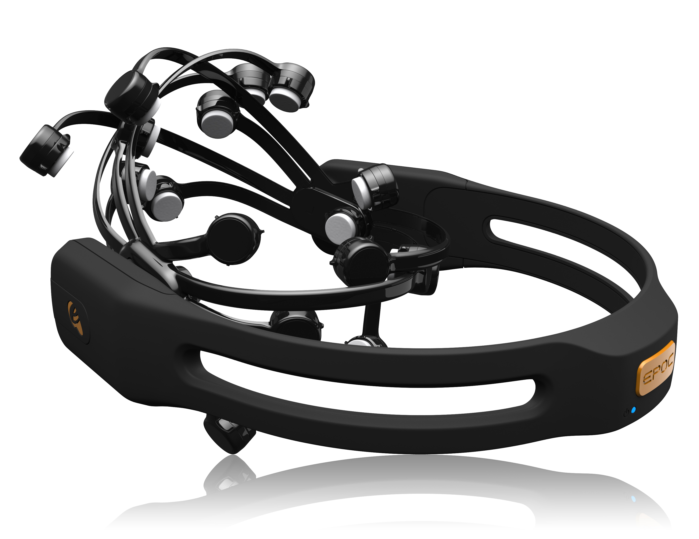
Emotiv EPOC Headset
Comparing non-epileptic EEG recorded by commercially available Emotiv EPOC headset and comparing to EMD recordings
All choices regarding electrodes were made with this comparison in mind
Shape, size, placement, material, etc.

Slide 12
Headset Design
Considerations:
^{Portability}
^{Comfort}
^{Lightweight}
^{Electrode placement}
^{Circuit storage}
^{Aesthetically pleasing}
Dimensions of average head, menton, and bizygomatic breadth:
^{14.5 cm, 24.1 cm, and 13.9 cm.}

Slide 13
Manufacturing
^{Modeling Software: Solidworks}
^{Easy to use}
^{Powerful}
Fabrication method: Objet30 Pro 3D Printer
^{Accuracy of .1 mm}
Precise detail in design aspects
^{Material: VeroBlue}
^{Finish: Matte}

Slide 14
First Prototype
Designed as one part
Hollow inside
“Cushion” to be placed around head for comfort
Bottom attachments for easy wire installation

Slide 15
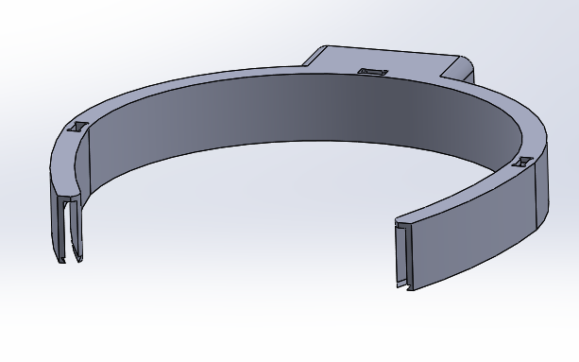
Bottom Attachment and Slot Mechanism

Slide 16
Solidworks Prototype Assembly

Slide 17
3D Printed Headset Prototype
Printed in parts
Cost: $75

Slide 18
Improvements
VeroBlue soft “fuzzy” texture, no need for “cushioning”
Shaped to fit around head - horseshoe shape
Slot mechanisms for electrode supports for easy assembly

Slide 19
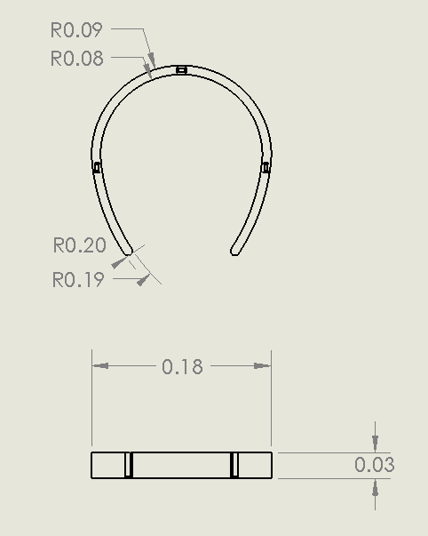
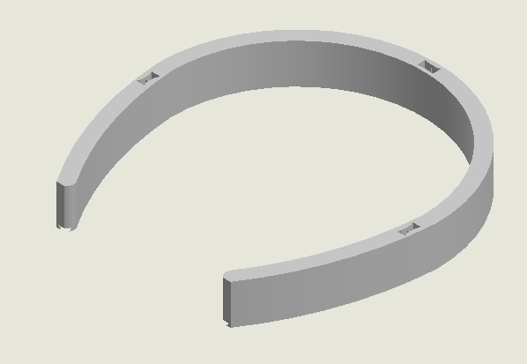
Final Design Headpiece

Slide 20
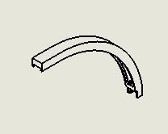
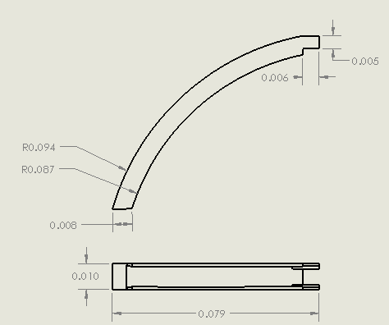
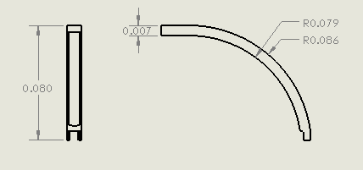
Final Design Electrode Supports

Slide 21
Solidworks Assembly

Slide 22
Final Design Slot Mechanism

Slide 23
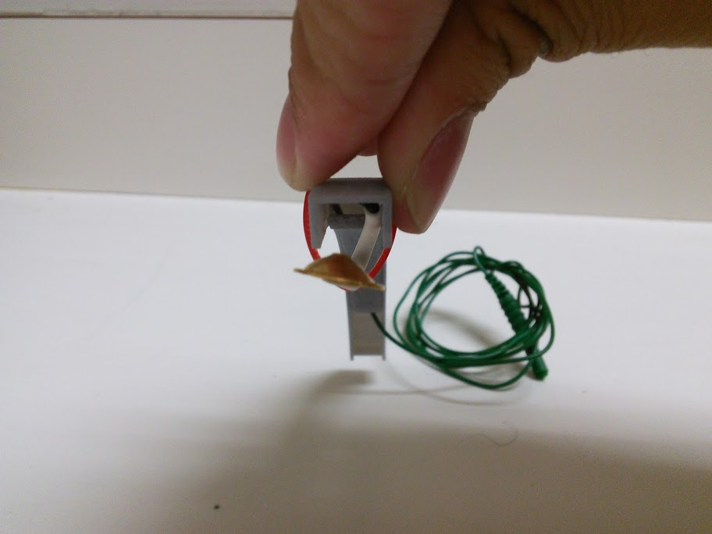
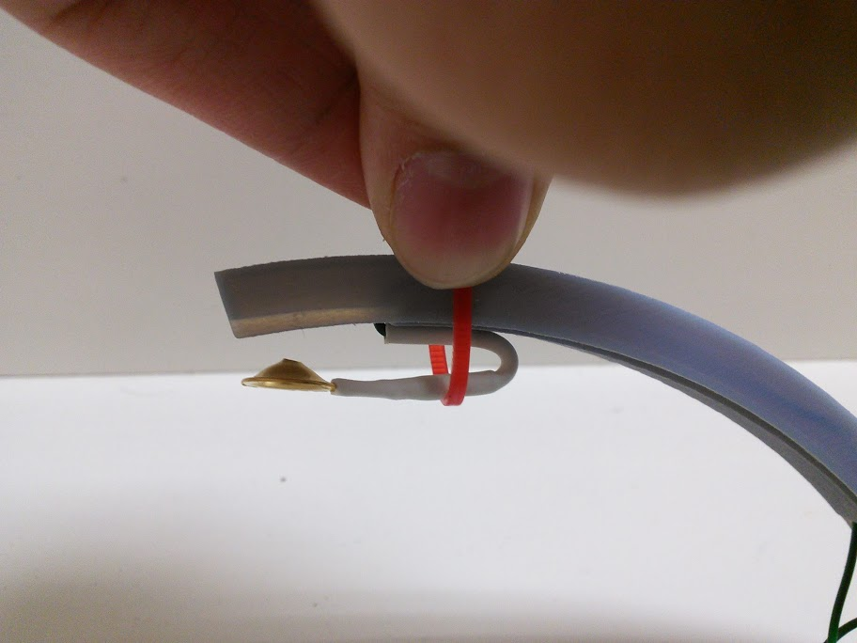
Electrode Placement
Notes:
Still a work in progress. Not finalized because we want to have the headset printed with the supports and fitted on the head properly before moving forward with electrode placement. Latch mechanism where a mock spring is created by bending the eeg electrode wire and putting it inside of a slit. A latch will then be used to fix it upon the head.

Slide 24
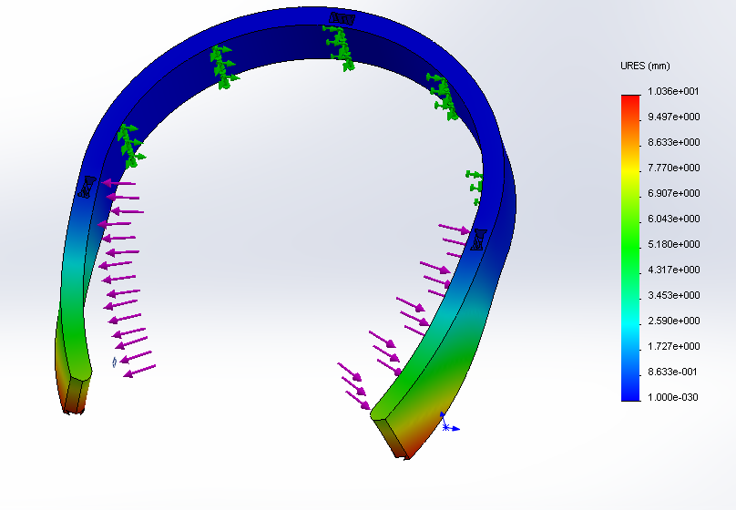
Stress Analysis
Tests
Durability
Fracture/bending
Applied force: 50 N

Slide 25
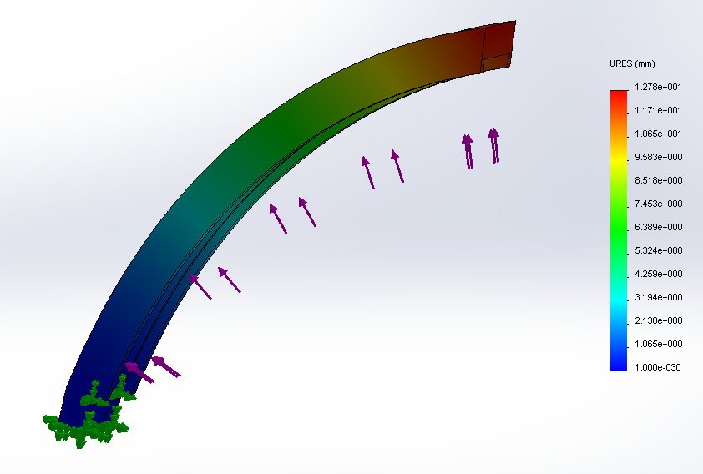
Stress Analysis
Force applied: 10 N

Slide 26
Microcontroller
Arduino Pro Mini
Operating Voltage - 5V
Input Voltage - 5-12V
Atmel 328P – 16MHz
Digital I/O pins – 14 (6 can be PWM)
Pins Provide/Receive – 40mA

Slide 27
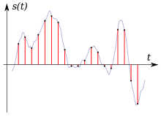
Microcontroller (cont.)
Analog Input Pins – 8
ADC - 10 bit resolution at 15ksps
Programmed by using a FTDI cable
Coding – C++
Flash memory – 16KB (2 KB for boot loader)
SRAM – 1 kB
EEPROM – 512 bytes

Slide 28
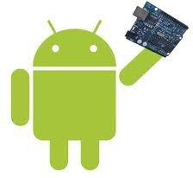
Microcontroller (cont.)
Open Source
Cross-platform compatible
Inexpensive
Very small dimensions, 18x33mm

Slide 29
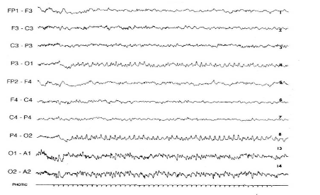
Epileptic Signal Characterization
There are many different methods of characterizing an epileptic EEG signal
The frequency of the brain wave could slow down.
There can be spike and sharp wave discharges when analyzing the amplitude over time.
There could be a different wave patterns occurring in the left temporal lobe, but nowhere else.
Large spike discharges that are widely spread over both hemispheres of the brain at the same time

Slide 30
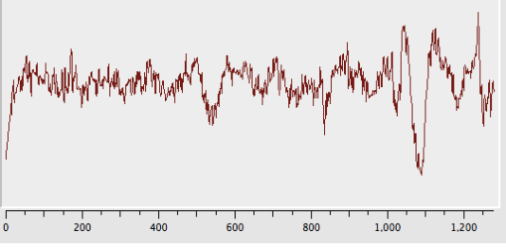
Epileptic Signal Characterization
Using the FFT (Fast Fourier Transform) we will be able to characterize any signal as either epileptic, non-epileptic, or non-determinant.
This is due to the 5Hz spike lasting longer than 5-10 seconds. This is what we will use to characterize seizure like signals

Slide 31
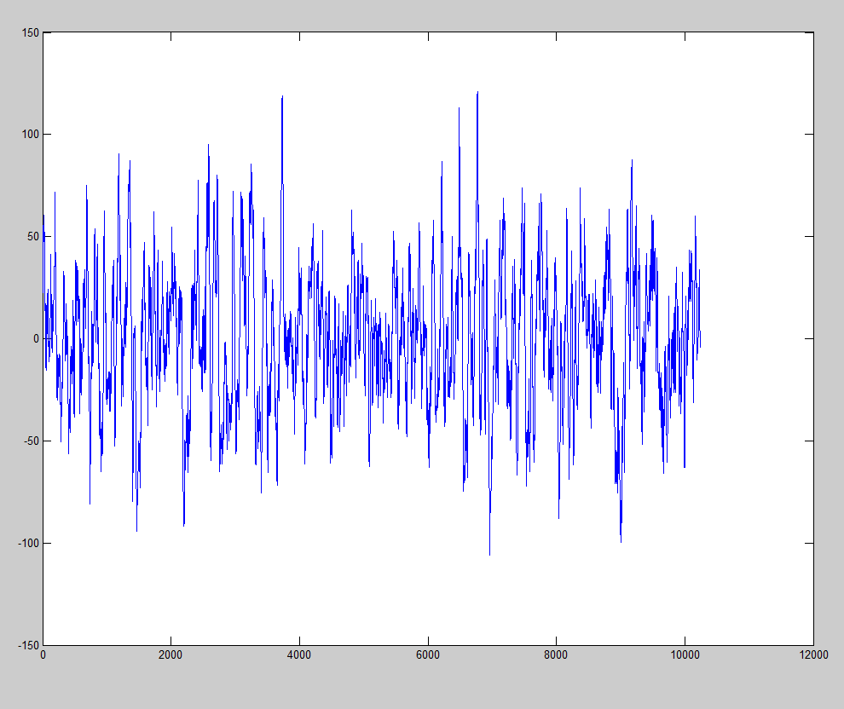
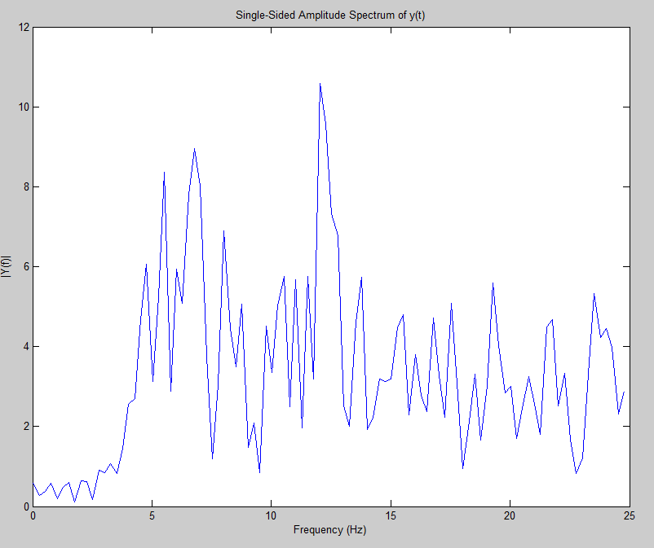
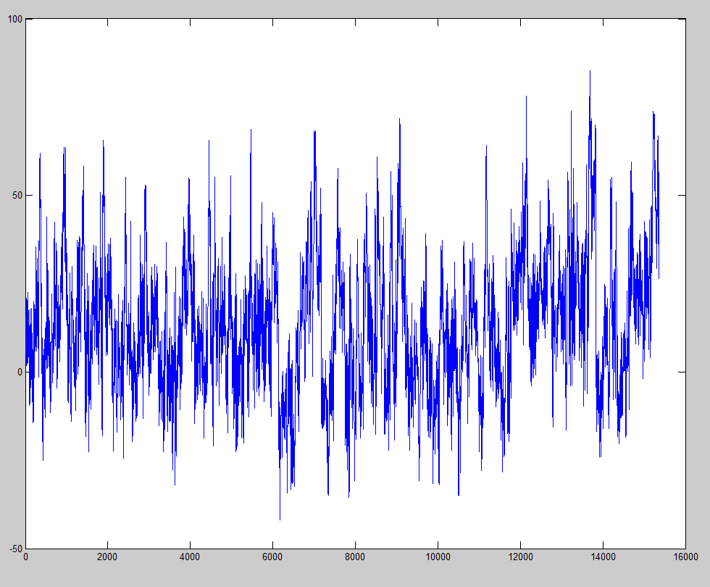
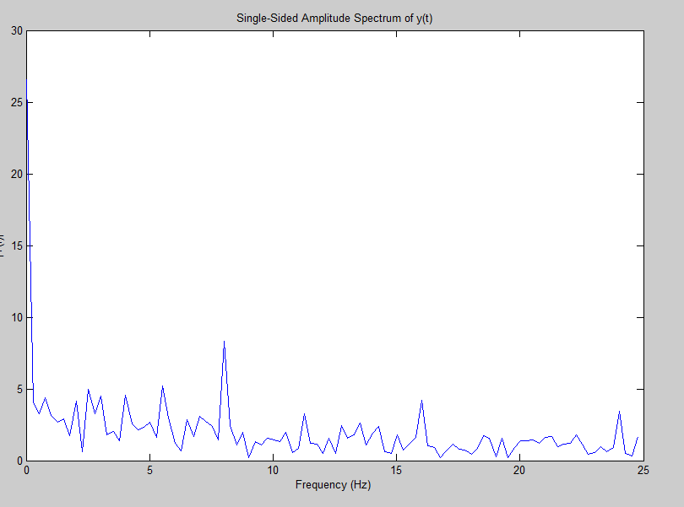
Epileptic Signal Characterization

Slide 32
Amplifier and Filter Circuit
Bio Amplifier
Circuit will perform voltage shifting to avoid any negative numbers when the microprocessor is doing A/D conversion.
Active Low Pass Filter
Circuit will perform low pass filtering to block any high frequencies from interfering with the EEG recording.

Slide 33
Bluetooth Module and Battery
Arduino Wireless Bluetooth Module
Sends all digital information to the android application
35mA connecting 8mA paired
Polymer Lithium Ion Battery
Powers the arduino board,circuit,and bluetooth module
850mAh 3.7V
Place 2 in series to achieve 7.4V in order to power arduino
LiPo Charger Basic
Charges the battery after completion
Contains status LED and micro-usb connector
Charges 500mAh. Takes 1 ½ hours to charge

Slide 34
Android Device
2013 Nexus 7
Android 4.4 (KitKat)
Android vs Apple
Tablet vs Mobile Phone

Slide 35
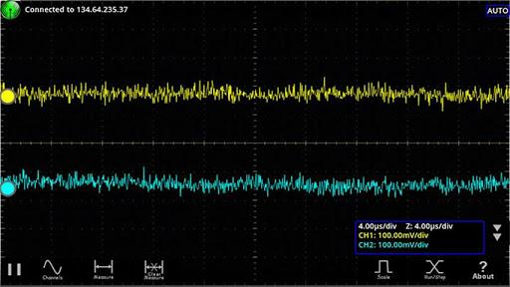
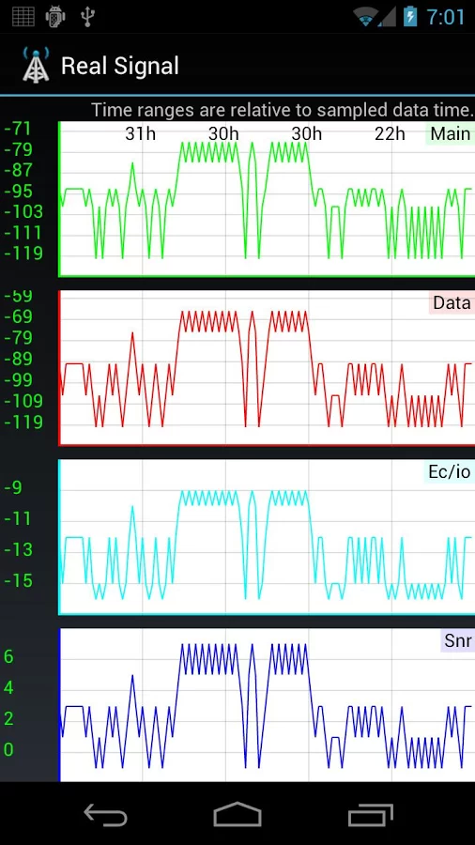
Android Application
Development – Eclipse
Built in Android SDK
Coding – Java
Emulator
Alarm system
Data stored on internal Memory

Slide 36
Design Overview
Electrodes
Isolation Amplifiers
Microcontroller
Battery and Signal Communication

Slide 37
Budget

Slide 38
Goals for Spring Semester
3D print headset
Complete full assembly
Methods for electrode placement
Create circuit and casing
Develop Android application
Testing for proper, comfortable fit and function

Slide 39
Conclusion
Success of the EMD will be based it being:
Efficient
Effective
Seizure detection
Low-Cost
Increases availability
Easy to Use
Intuitive controls
Portable
Wireless

Slide 40
Epileptic Monitoring Device
Final Design Presentation – December 4 2013
Mark Curran (CE), Rachel Kolb (BME), Kevin Pineda (BME), & Timothy Skinner (EE)
Primary Advisor: Dr. Brett BuSha Secondary Advisor: Dr. Ambrose Adegbege

Slide 41
Questions?
Comments?
Concerns?

